Slide 1


UI DESIGN AND IMPLEMENTATION
Task 5
Group 18

Slide 2

Content
Introduction
01
02
Key Features
Design Principles
03
04
Applications Name
Design elements
05
06
Conclusion

Slide 3
Introduction
Our Disaster Management Mobile Application (ResQ) aims to provide timely and critical information to users during natural or man-made disasters. The primary goal is to facilitate communication, provide real-time updates, and offer resources to help users stay safe and informed. Effective UI design for such an application must prioritize clarity, usability, and reliability under potentially stressful conditions.
1

Slide 4




Key Features
Real-Time alerts and notification
Emergency contacts and services
Location based services
Community communication
Accessibility features
3

Slide 5



Design Principles
Accessibility
&
Inclusivity
Clarity
&
Simplicity
Consistency
&
Familiarity
2

Slide 6

Applications Name
An application name is more than just a label—it is a critical aspect of the app’s identity and plays a significant role in user engagement, branding, and functionality. The name chosen for our app is “ResQ”.
The term "ResQ" was gotten from the creative variation of the word "Rescue," often used in branding for applications, products, or services related to safety, emergency response, and disaster management.
1

Slide 7
Design Elements
It envolves representing our requirements by classifying them according to the various users who are ;
User
Emergency responder
Admin
8

Slide 8
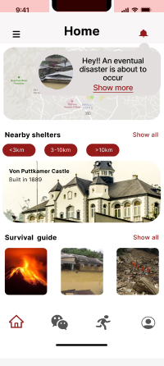
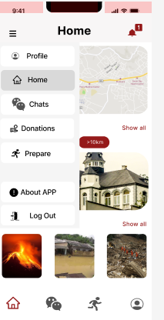
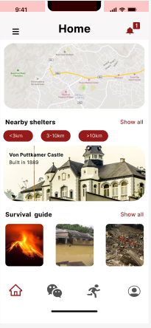
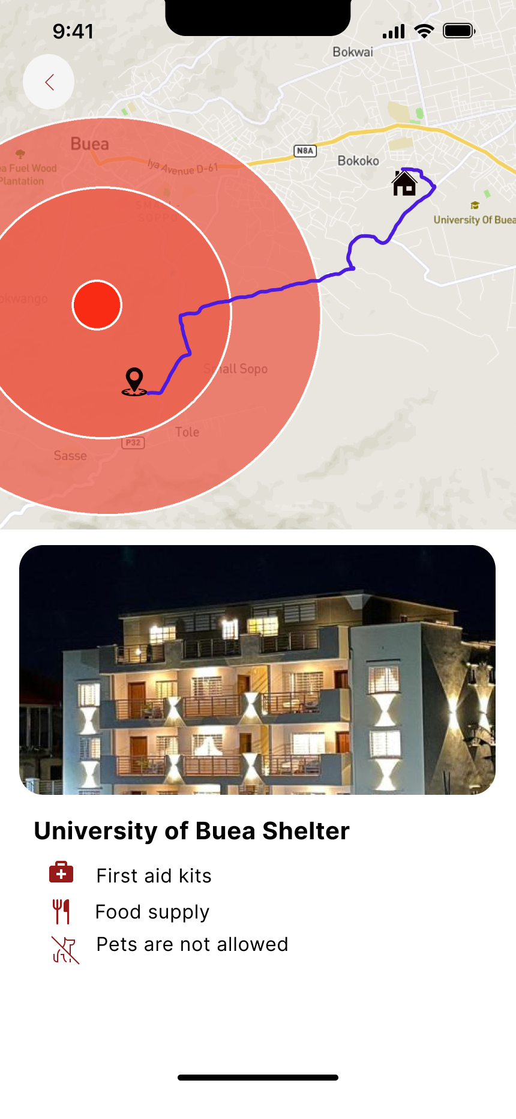
User Pages
8

Slide 9
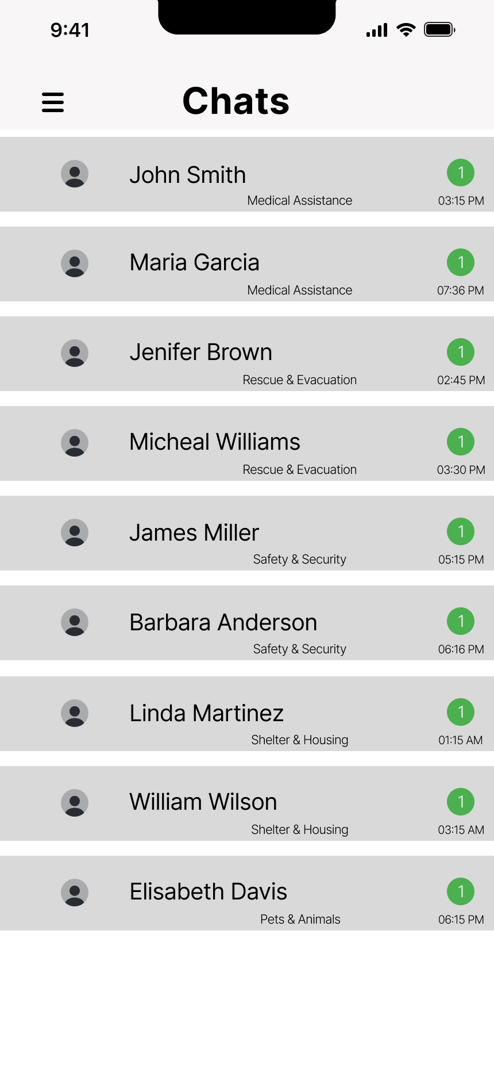
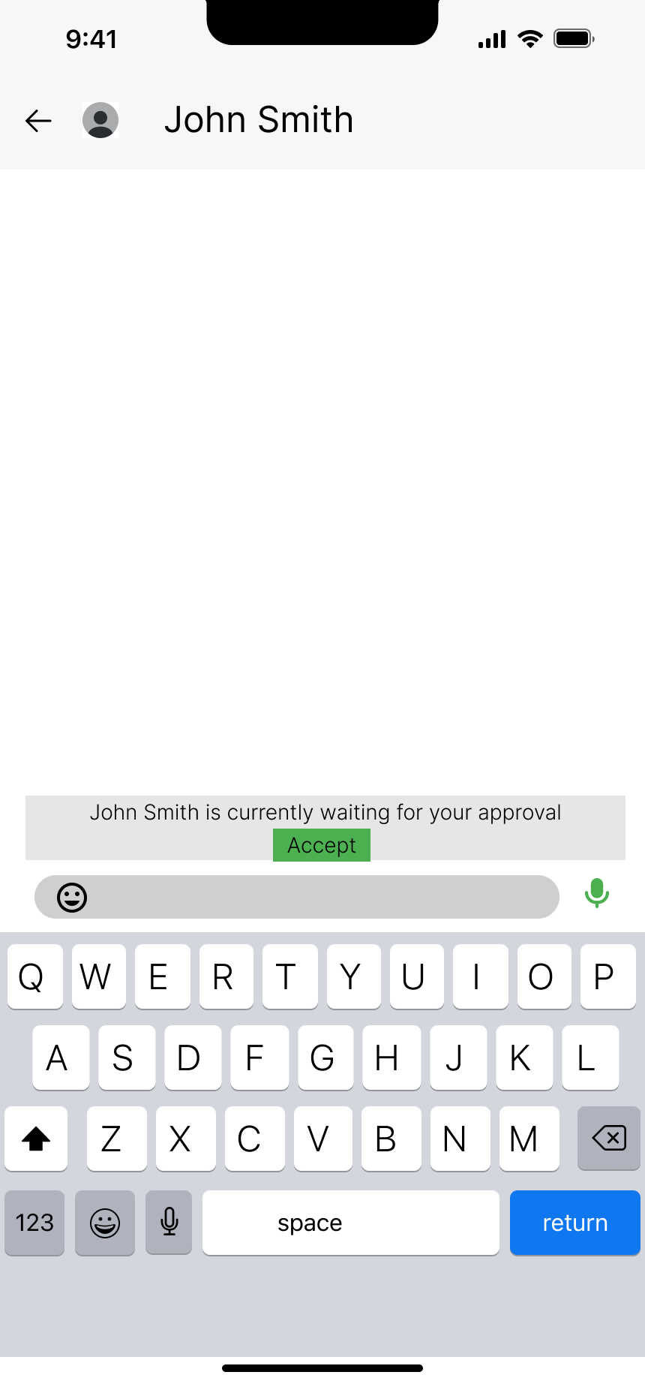
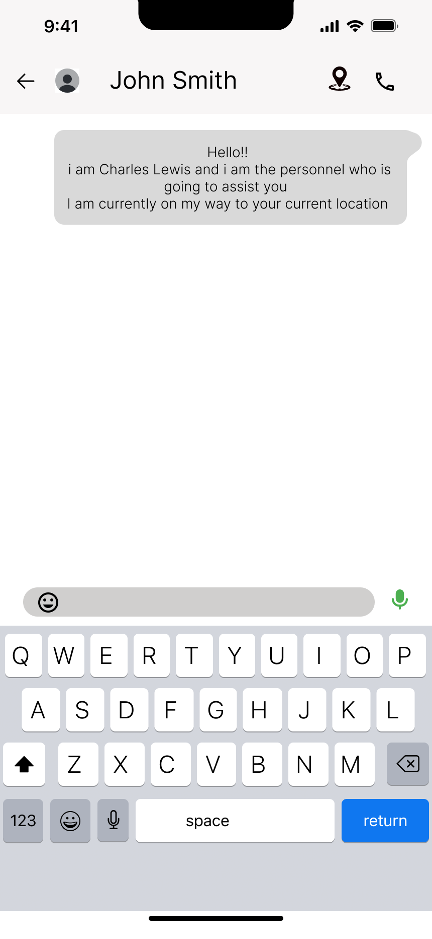
Responder pages
8

Slide 10
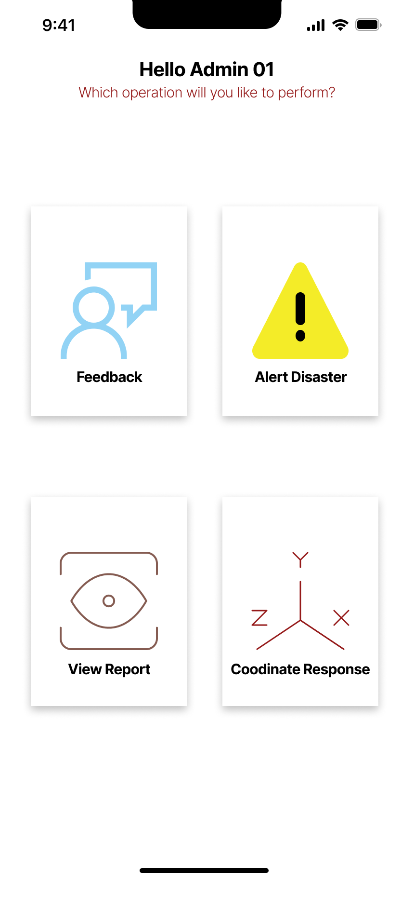
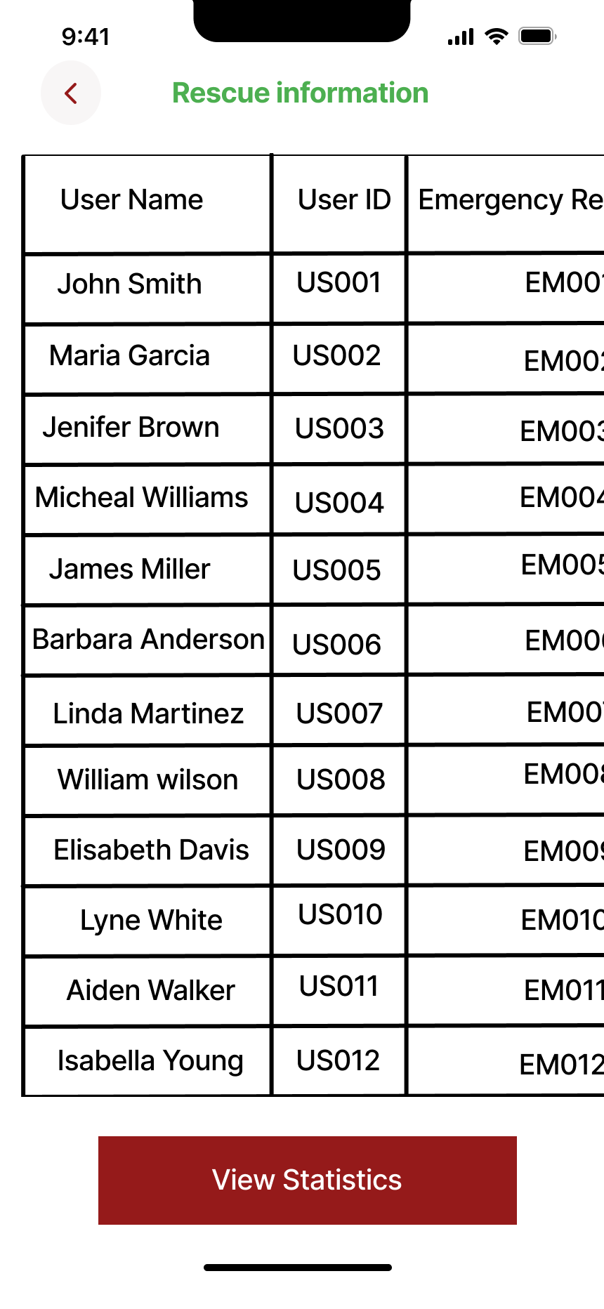
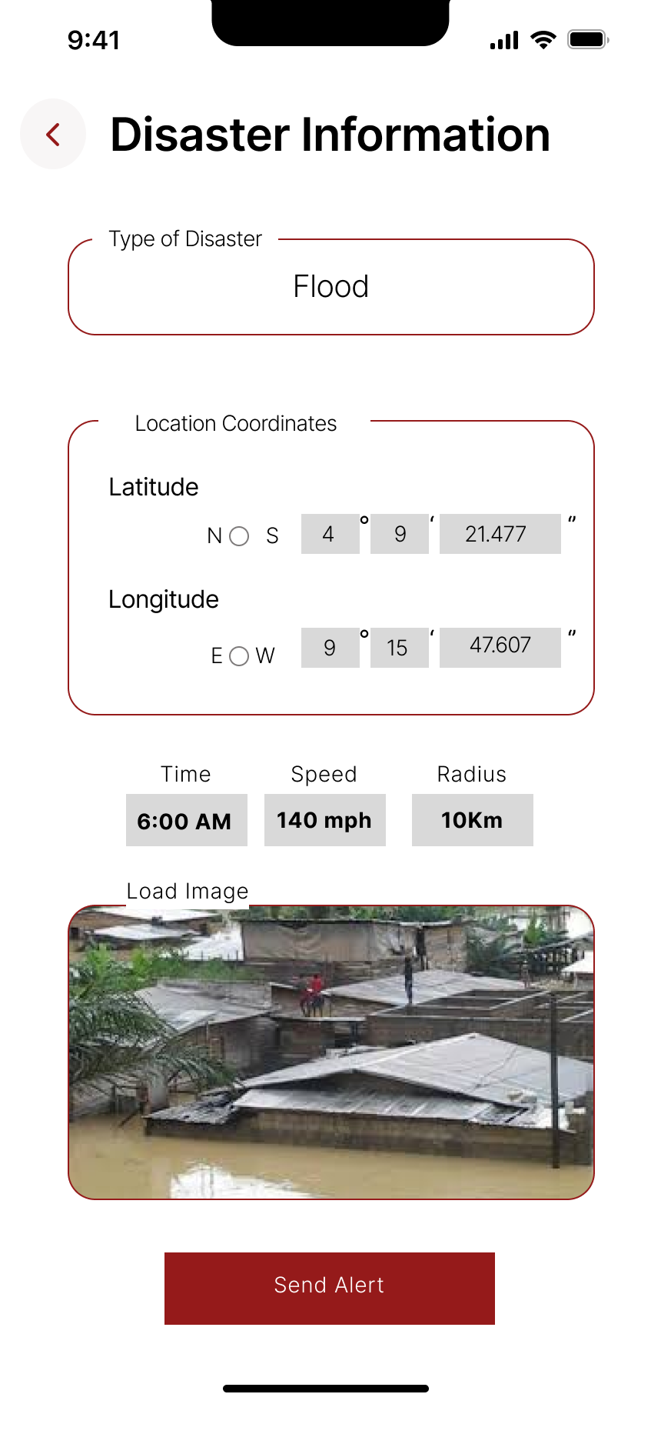
Admin Pages
8

Slide 11
CONCLUSION
Designing the user interface (UI) for a disaster management mobile application is a critical and complex task that requires balancing functionality, usability, and accessibility. This application is not just another tool; it's a lifeline during crises, making the stakes high for delivering a well-thought-out and user-friendly interface.
13

Slide 12
Thank you

